Slide 1
Introductory General Chemistry
Chemistry 3A
Lab Safety
Mitch Halloran

Slide 2
Lab Safety
The first discussion in a lab course
A priority for:
Your fellow students
Your instructor
The org
Chemistry Department
Math, Science and Engineering Division (MSE)
Fresno City College (FCC)
State Center Community College District (SCCCD)
The People of the State of California: regulations and law

Slide 3


The Lab Safety Contract
Pages 5, 6 and 7 in Lab Manual
PERSONAL PROTECTION
Eyes: approved safety GOGGLES (not glasses)
Body/clothing: lab coat to knees (at least mid-thigh)
Below knee:
Long hair, accessories, scarves

Slide 4
The Lab Safety Contract
PERSONAL PROTECTION (cont.)
No eating, drinking, chewing, applying cosmetics
Thirsty? Need to drink water?
Step outside lab but only when you are not monitoring an experiment
Be attentive about hand-washing
if you have handled any equipment and especially chemicals, wash your hands first before you step outside and if you might put your hands on face/eyes, food, or whatever
Some experiments will require use of hand protection with nitrile gloves, which will be provided
Always use appropriately fitting gloves: if your hand is too small for the glove, you may not have an effective grip

Slide 5
The Lab Safety Contract
COMMUNITY PROTECTION
Learn first thing where these are:
Fire extinguishers
Fire blankets
Fire alarms
Safety showers (yes, you will get soaked)
Eyewash fountains
First Aid Kits

Slide 6
The Lab Safety Contract
COMMUNITY PROTECTION
Lab aisles and corridors must be clear and trip-free of lab equipment, backpacks, chairs out of their place
Access to exits and emergency equipment unobstructed

Slide 7
The Lab Safety Contract
COMMUNITY PROTECTION
Lab aisles and corridors must be clear and trip-free of lab equipment, backpacks, chairs out of their place
Access to exits and emergency equipment unobstructed
Chemical reaction going on? Keep your attention on it frequently if not constantly, and especially if it’s your first experience, first time performing the operation!!

Slide 8
The Lab Safety Contract
POLITENESS & CONSIDERATION
Always leave a place in the condition as you found it
And if you find it in awful condition, let me know, so I can tell you how you should leave a place in proper condition
Clean up after yourself
NO CHEMICAL WASTE OR ANYTHING ELSE IN SINKS!
Everything to be disposed has a proper container, whether it is a solid (paper towels, matches, &c) or a liquid

Slide 9
The Lab Safety Contract
Broken glassware? We have a place for it
Pieces of glass on floor/bench?
NEVER grab broken glass with your hand, gloved or otherwise!
ALWAYS find a (hand)brush and collecting/dust pan and sweep broken glass into the pan
Inspect your glassware before experiment: make sure you do not use dirty or chipped or cracked glassware

Slide 10
The Lab Safety Contract
Inserting glass tubing & thermometers in holed stoppers
Very avoidable injuries are caused by wrongly inserting glass tubing into holed stoppers!
Apply glycerin (or at least dishwashing detergent) to the hole and surface of tubing
Push tubing into hole, using a rotating motion
Insertion should be with ease and no great resistance
Do not have the tubing insertion and your palm in same path!
Wash stopper & inserted tubing liberally with water when done
Unfamiliar with glassware? Ask instructor what it is and what it’s used for

Slide 11
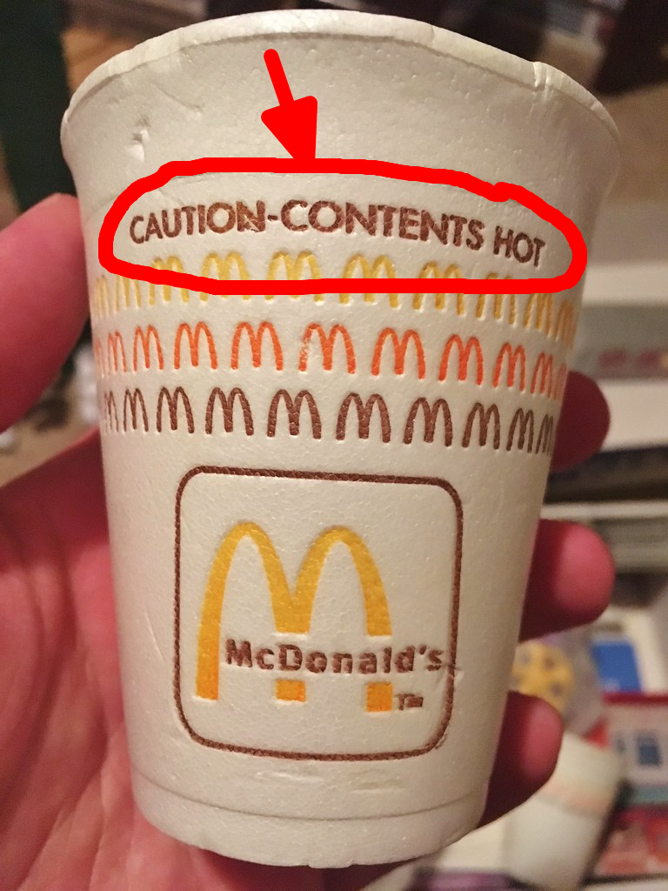
The Lab Safety Contract
HOT STUFF
Always consider glassware to be hot if around heating equipment
Handle hot glassware with tongs or hot pad
Keep hot glassware on equipment intended to hold it until the glassware is cooled. Do not set hot glassware on cold surface, including just the bench
Heating a reaction in a test tube?
The mouth of the tube should always be pointed away from any person!
At the appropriate moment in the semester, videos will be required viewing for heating reactions in a test tube

Slide 12
The Lab Safety Contract
HOT STUFF
No heat source unattended ever
Gas burners and hot plates off when not in use
Using a flammable solvent or liquid?
Those should only ever be heated using a hot plate, and usually in a water bath heated by the hot plate
All reactions involving VOLATILE solvents/liquids MUST BE DONE in a fume hood
Make sure that the sash of fume hood is at the proper setting and learn the safety features (alarms) of the fume hood

Slide 13
The Lab Safety Contract
HANDLING CHEMICALS
Treat all chemicals as a safety
Pipetting by mouth is strictly forbidden
Use a proper volumetric transfer device or system, like a pipette bulb
Never put your nose over a container with a substance in it
If you absolutely must sample the volatile substance by smell, use your hand to fan vapors from mouth of container towards your nostrils carefully

Slide 14
The Lab Safety Contract
HANDLING CHEMICALS
When you take a solid or liquid stock chemical out of its container, you should not put excess chemical back in that container
For this reason, it is better to take smaller quantities at first and add to the weighing dish or volumetric container than take too much in one big over-do
Never waste reagents and consumables
If an experiment says to weigh out 10.0 grams of a chemical, take the time to weigh that out accurately
If you want 250 ml of liquid, generally take that amount and not more
You have a community to consider, and they are in the queue not wanting to find out nothing is left for them

Slide 15
The Lab Safety Contract
HANDLING CHEMICALS
Having problems getting a solid or other thing out of a reagent container? Inform the instructor.
If you’re getting a reagent, particularly a liquid stock, out of its container, make sure that if it drips down the side of the container when dispensing, that it does NOT drip on the identifying label. Handle the container directly on the label.
ACIDS
ALWAYS slowly add concentrated (stock) acids to stirring (or at least swirling) water during dilution
NEVER add water solvent to concentrated acids: the heat of the reaction can be very intense and can cause EXPLOSIVE release

Slide 16
Other Useful Info
Whiteboards
Microfiber cloth or eraser is usually enough
If board staining is seen after cloth cleaning, try a 50% isopropanol (1:1 [v/v] rubbing alcohol:water). Wet a cloth and quickly apply
A more determined effort can use high concentrations of isopropanol
Do NOT use any cleansers or detergents on whiteboard, and that especially includes Simple Green used in the lab

